Slide 1
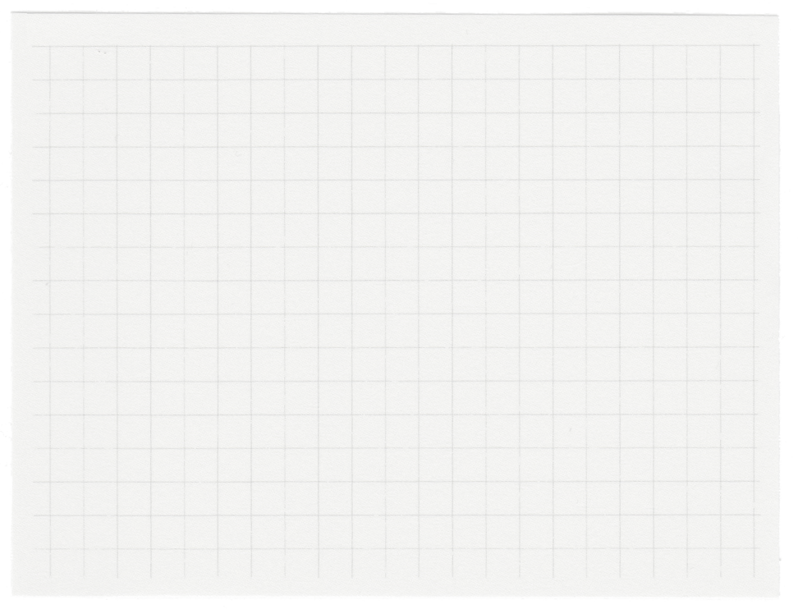













MINOR
PROJECT
PRESENTATION
BY:-Anjali Kumari Singh
Roll no:21051459

Slide 2
BMI HEALTH
RECOMMENDATION SYSTEM

Slide 3

Acknowledgement
I would like to thank our project faculty Dr.Banchhanidhi Dash ,KIIT University for his continuous guidance and support throughout the project, so that the project meets its requirements since the starting to the completion.

Slide 4
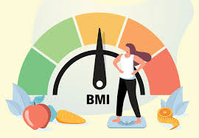
PROJECT AIM
The aim of the project is to create a BMI Health Recommendation application which will seamlessly calculate the BMI of the user based upon the details he has entered, and gives health recommendation based on user’s values.
01.
FRONTEND
BACKEND
02.

Slide 5
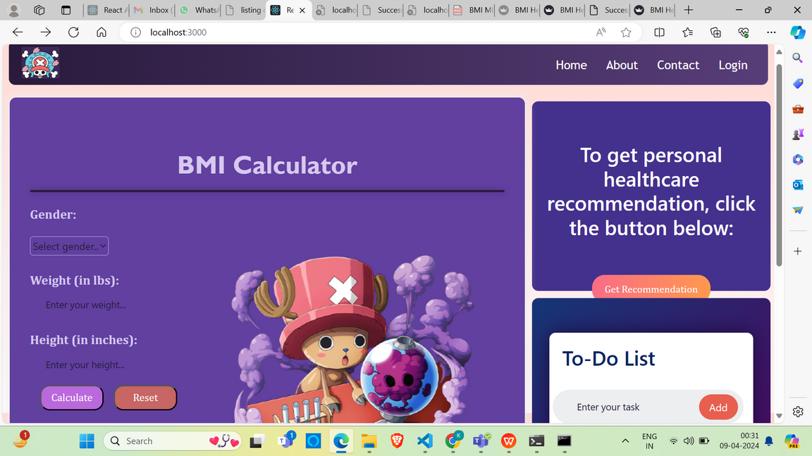
What is Frontend ?
Frontend development basically involves the creation of graphical user interface of a website through the use of HTML and CSS page structure and style information.
Frontend of a website is the part of the website that the users interact with.All the navigation systems, the buttons that we see on a website, the dropdown menu and so on, all of them are frontend components

Slide 6
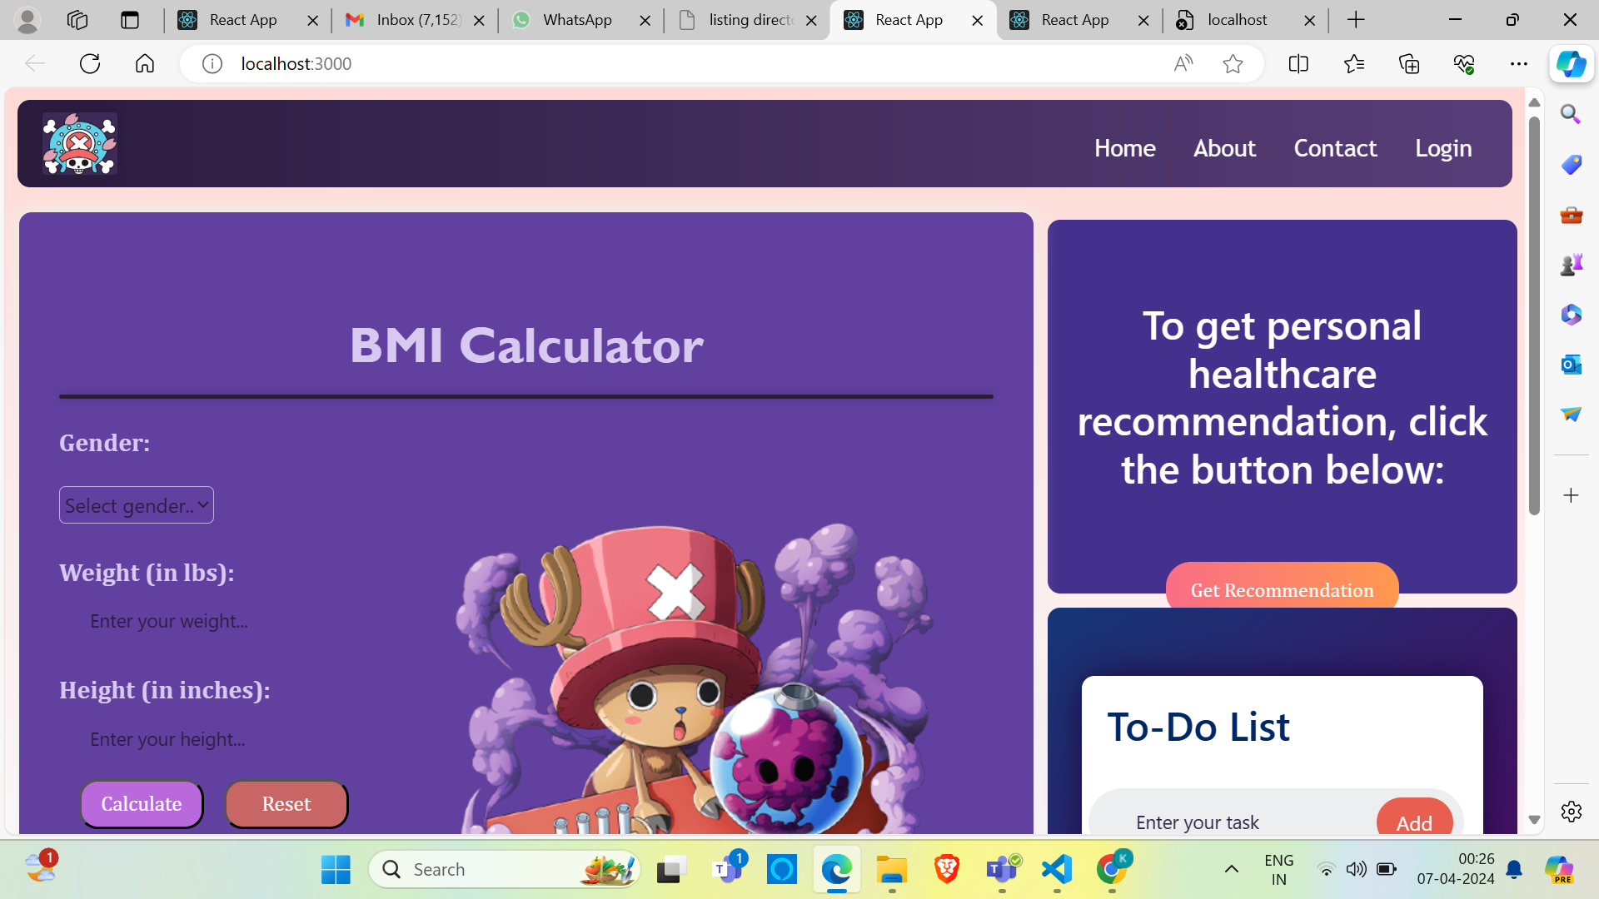
SHOWCASING SOME FRONTEND ELEMENTS OF OUR PROJECT
introduction page

Slide 7
SOME FRONTEND COMPONENTS OF OUR PREVIOUS SLIDE
01 About
02 Calculator
03 Contact
04 footer
About has a css file for styling it including design layout and variation in display.
it also has a javascript file, which has all the variables , details of the page about.
calculator has a CSS file for styling its features .
Now comes the javascript file where it is mentioned and all the operators and variables like buttons are mentioned like gender,weight and so on. The constructor method initializes the component’s state with three properties: weight, height, and bmi in state we have intitially the values of weight and height are empty so BMI is NULL ;Methods like handle change method and calculate BMI method in which whenever the use presses calculate BMI, BMI is calculated and returned Export component makes the files available for import at other places also.
an additional navigation used for displaying general information that a user might want to access from any page within your site. text about the site, company info, copyrights, links to a contact form, sitemap, FAQ and other such resources.JSX allows us to have HTML like codes for building UI components. The outermost div with the class footer-out wraps the entire footer content.The main section represents the footer elements which has quick navigation links to pages like home about us. The use of social icons have been done for apps like github and LinkedIn.Export means noe footer can be exported to other parts of the application
contact is basically a form which has 3 imports one for the React ,and other 2 are for image import now we have JSX structure for how the UI will look like ;ther are action and method form elements which tell where the form will go.TextInput is there for required fieldsand textarea area provided to the user for filling details.It also has the CSS files for styling certain parts of the form.The last line export defines the use of contact form by being imported to the other places

Slide 8
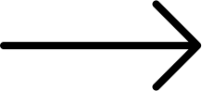
gives the requiered recomendation.
It has a HandleClick function which will redirect us to the local host 8501 where with the help of Streamlit we get recommendation
Creates a root DOM node for the React application by selecting the element with the ID root from the HTML.This line is a call to the reportWebVitals function, which can be used to log performance-related metrics or send them to an analytics endpoint.
HEALTHCARE RECOMMENDATION
INDEX
other frontend components
LOGIN PAGE
SIDEBAR
In login page, we have components like username password and signup button it is fully responsive .It first takes the user’s data i.e username and password and checks if everything is correct and logging the user in.If he is a new user then the option of signup is also there.
The Sidebar component is a stateless functional React component that provides a sidebar navigation menu. It imports React and a CSS file for functionality and styling. The component is exported for use across the application and is designed to offer consistent navigation
TODO
RESPONSIVE NAVBAR
TODO allows the users to add tasks and use them and modify them.use state has 2 state variables task and new tasks where tasks is an array which holds the tasks and new task string represents current value.WE also have a CSS component which is used for styling.
This navbar is fully responsive and has jsx, js and css files .within JSX file HTML type code is there for where the icon will open. It has buttonsfor Home, about, contact, login.These buttons have hover effect.

Slide 9
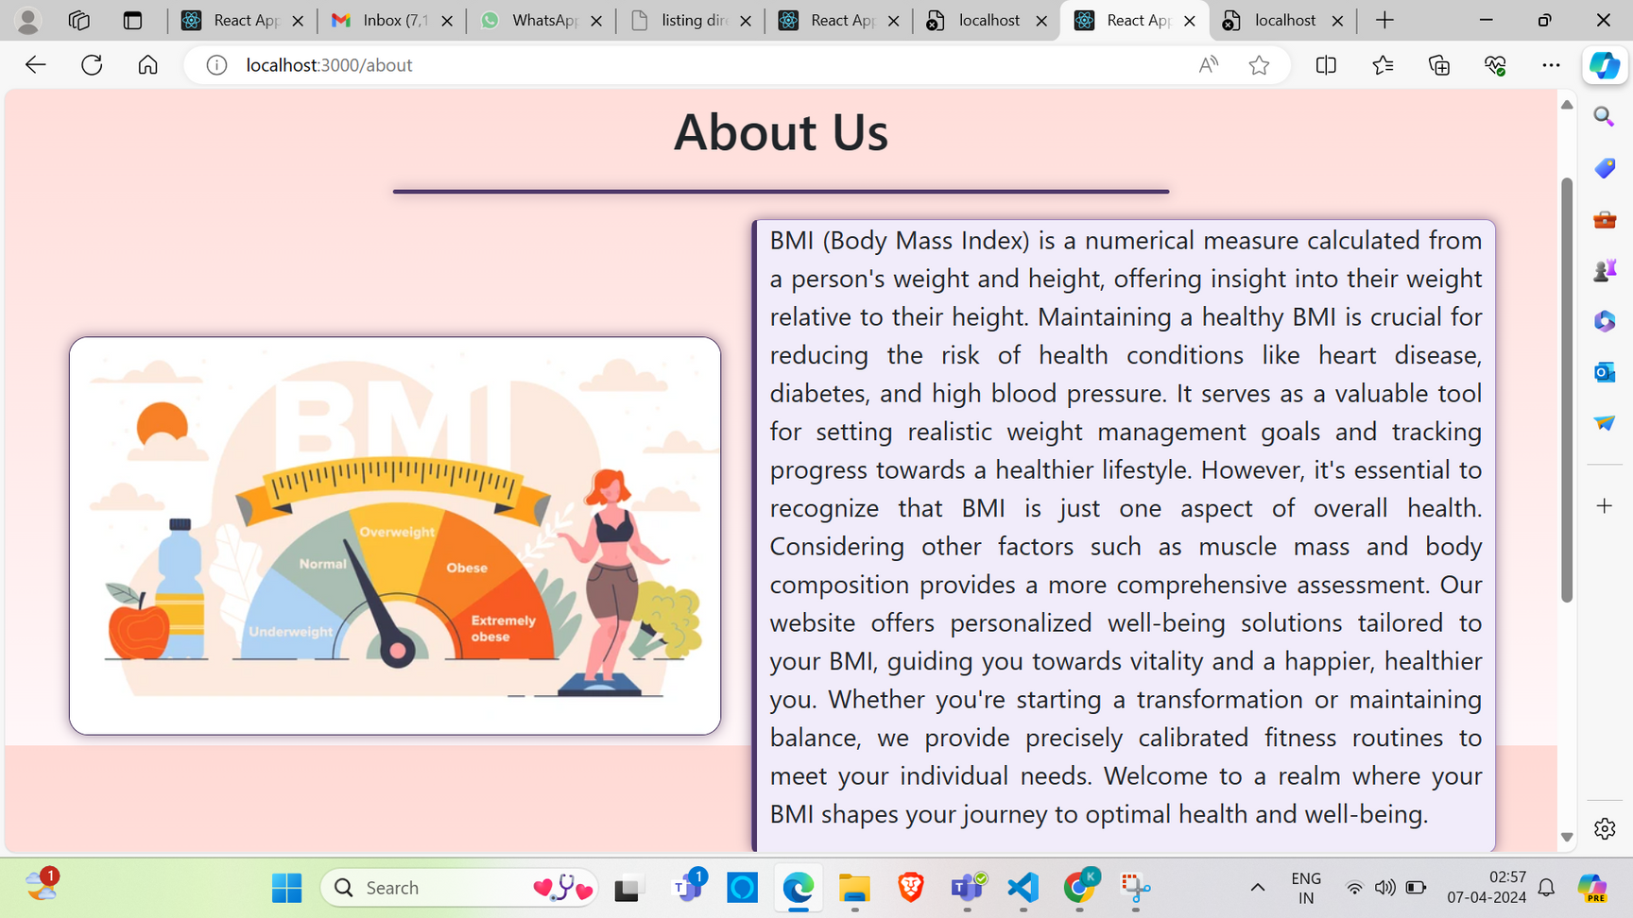

Slide 10
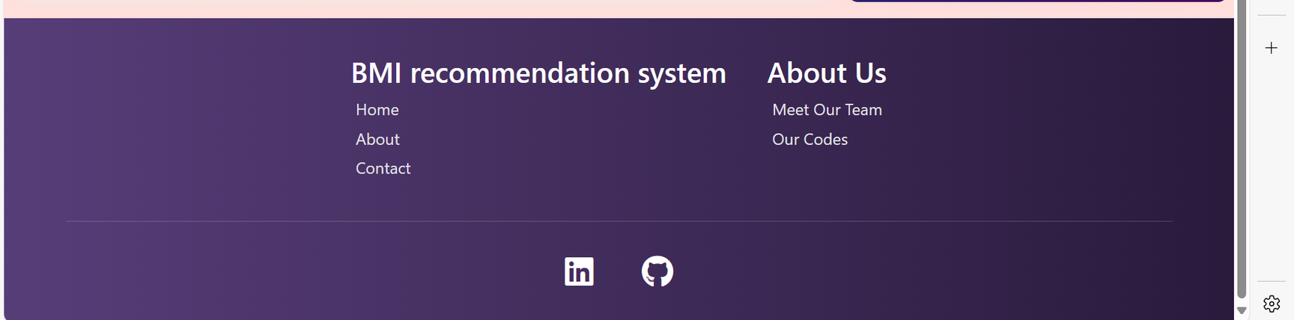

Slide 11
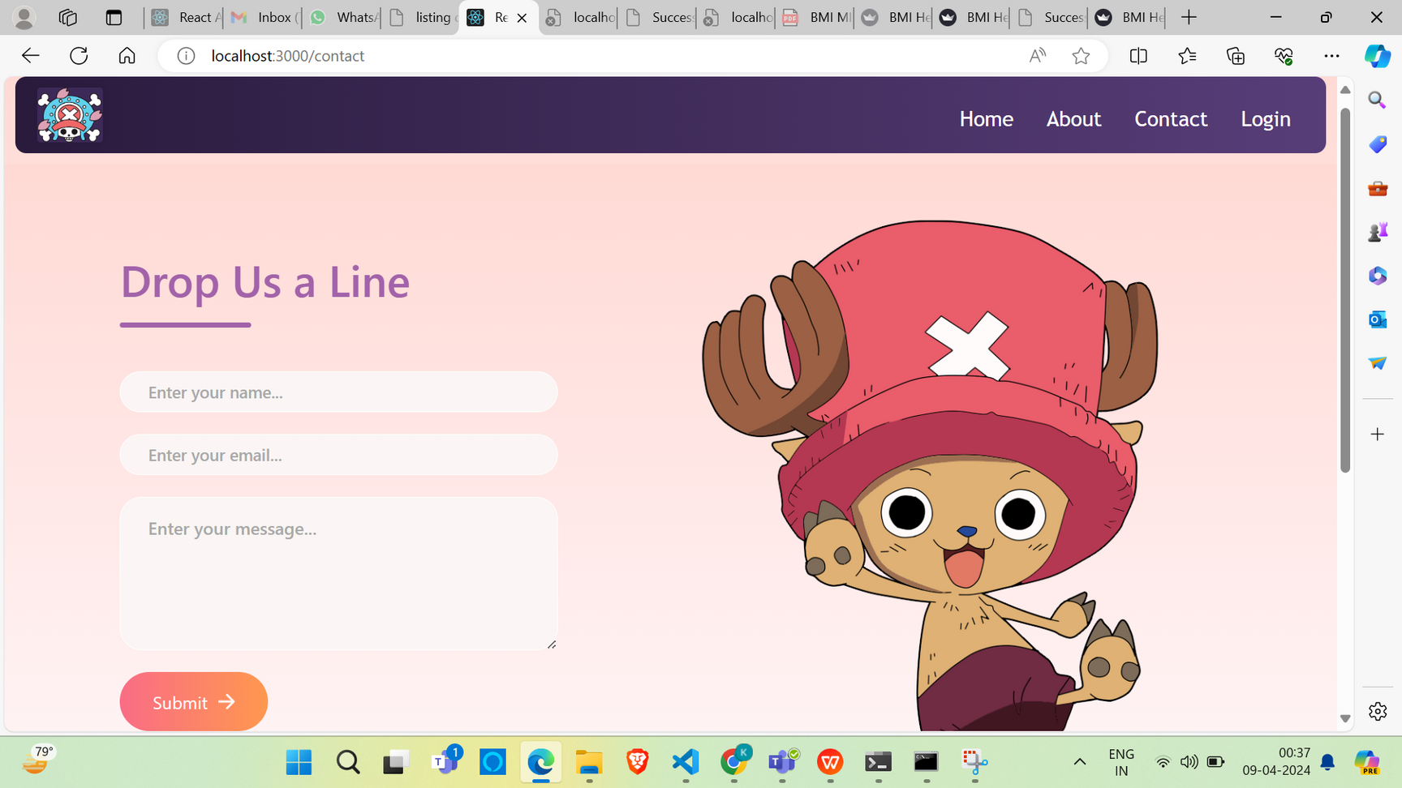

Slide 12
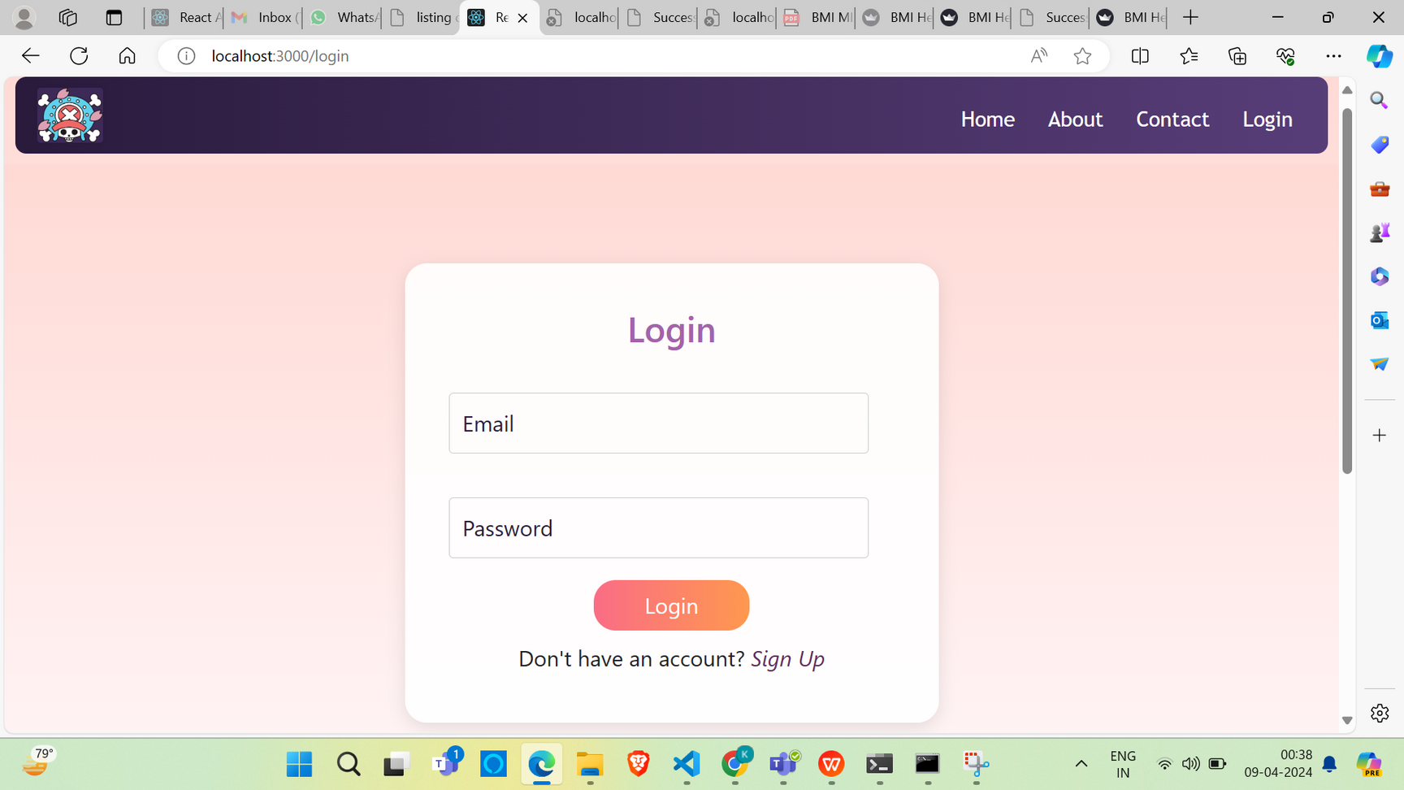

Slide 13
Backend
The back end refers to parts of a computer application or a program's code that allow it to operate and that cannot be accessed by a user.
In this application , the technologies used for backend are Flask and Streamlit

Slide 14
BACKEND FOLDER app.py
01
02
03
04
is a Python script using the Flask web framework and SQLite database to create a simple user authentication system.
initialize_database(): This function sets up a SQLite database named users.db. It creates a table called users if it doesn’t already exist, with columns for user ID, full name, email, username, and password. The user ID is set to auto-increment with each new entry.
is_valid_email(email) and is_valid_password(password) is used for email and password verification .It checks if the email and password are provided, retrieves the user from the database, and verifies the password using the hashed value. If successful, it returns a login success message; otherwise, it returns an error.
iinitialize database runs to initialize datbase when the script is run.app.run(debug=True) starts the falsk app and gives detailed error messages
.

Slide 15
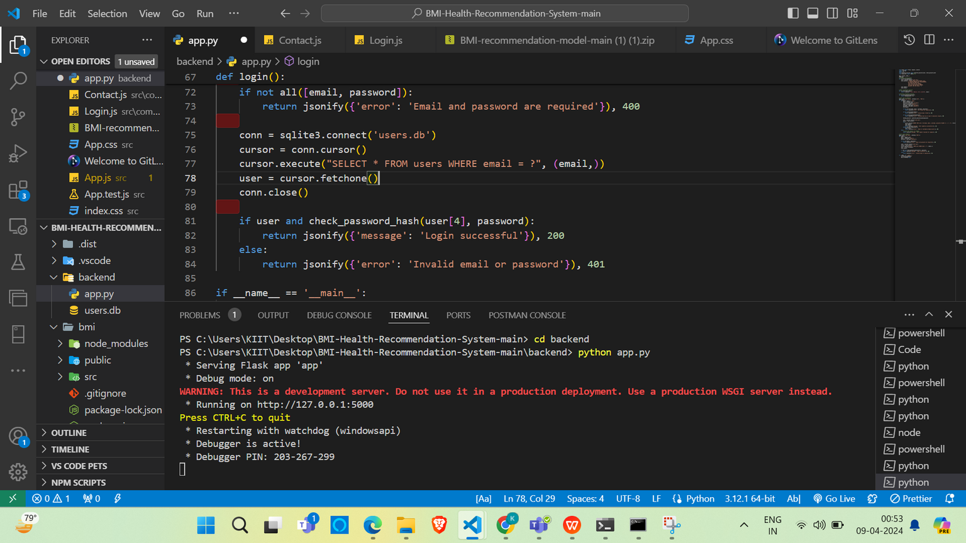
Execution of app.py
app.py is basically using flask and SQLite.The combination of Flask and SQLite in this code provides a full backend solution for user authentication, including user registration and login functionality. Flask handles the web server and API part, while SQLite manages data persistence. The following shows how execution of app.py is done in this app

Slide 16
Environments created and installed
installed flask,streamlit in the path of app.py.first I opened the BMI Recommendation model main folder and since I did not have SQLite in my system, I installed scikit-learn .It is one of Python’s machine learning library that provides simple and efficient tools for data mining and data analysis.command used “pip install -U scikit-learn”.
Then I went for installing streamlit.In the same terminal.Streamlit is the interface that interacts with the user, collects input, and displays the output from the machine learning model and recommendation system.
command used for installing streamlit”pip install streamlit” and for running BmiModel.py for backend, we used the command “python -m streamlit run Bmi-Model.py” then UI comes where we can enter the deatils of the client or logged in user and recommendation is given if he is overweight fit or underweight.
In the Backend folder of BMI-Health-Recommendation-System-main, we used flask framework as well .The combination of Flask and SQLite in this code provides a full backend solution for user authentication, including user registration and login functionality. Flask handles the web server and API part, while SQLite manages data persistence.

Slide 17
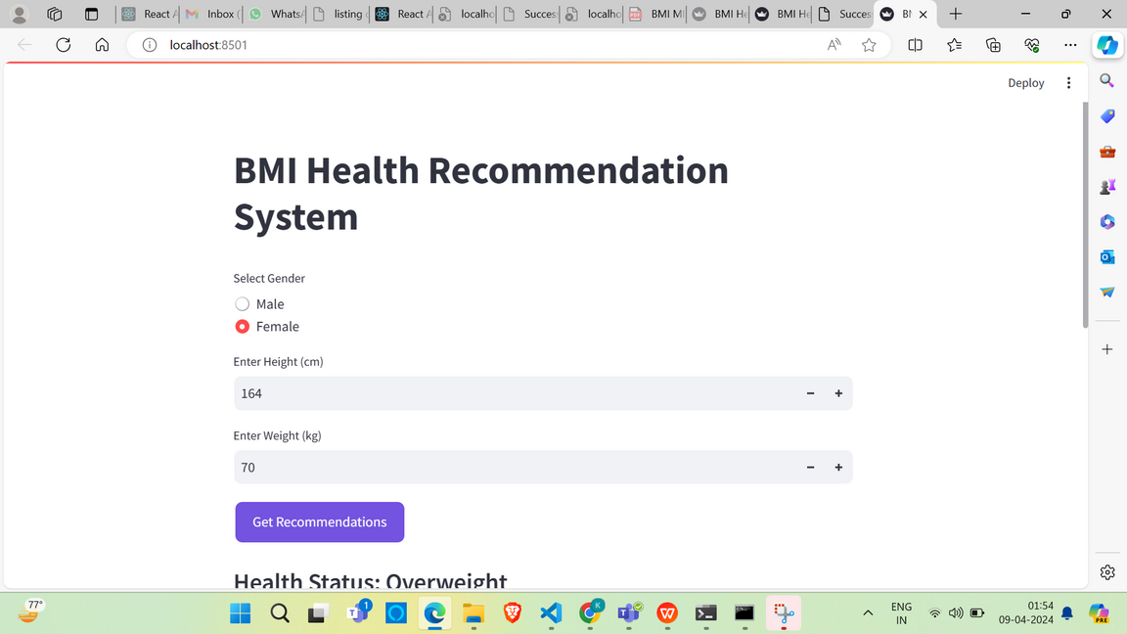
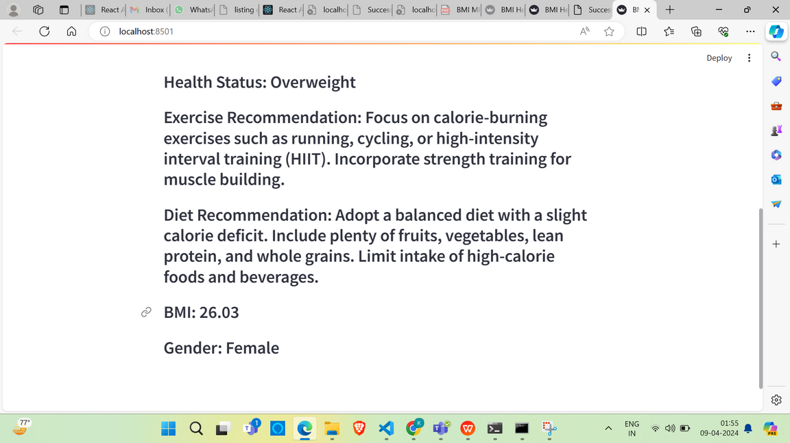
Screenshots of working Backend

Slide 18
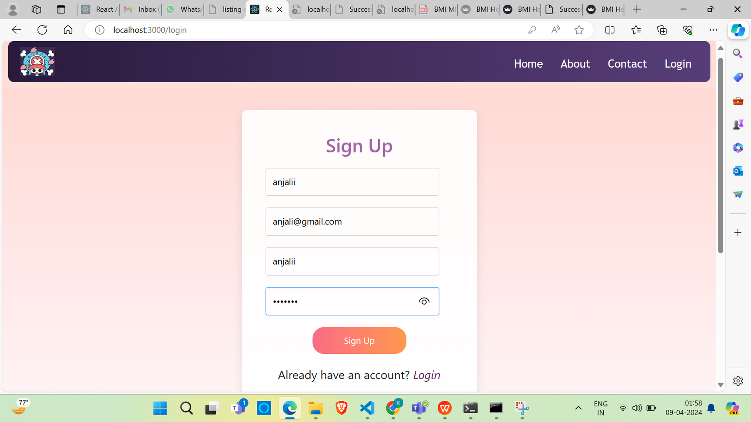
successful login and Invalid login

Slide 19
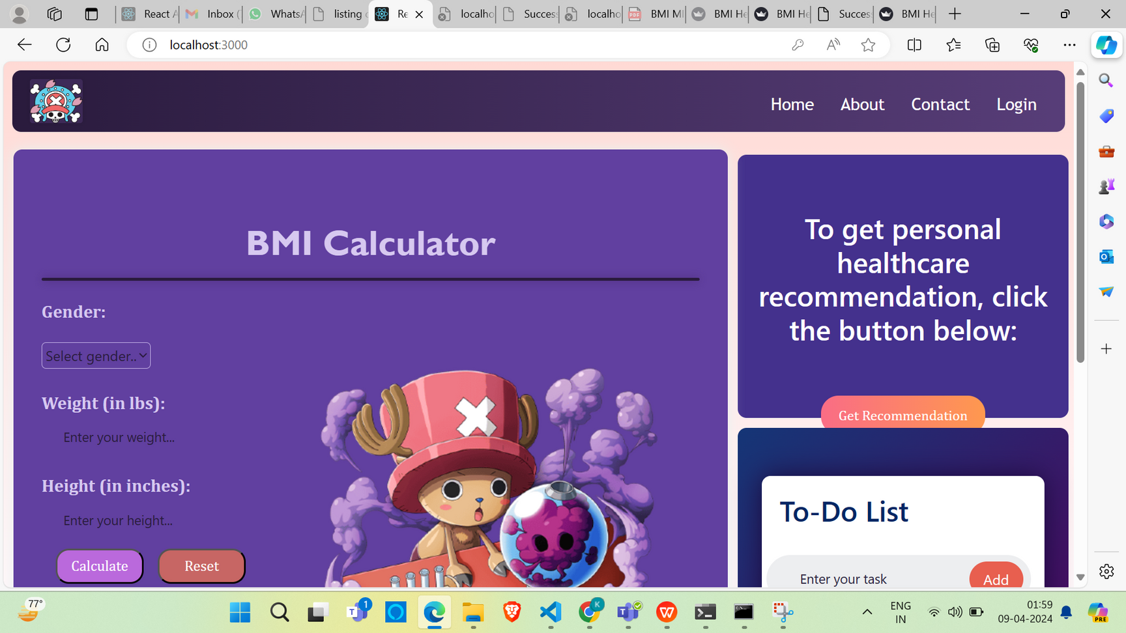

Slide 20
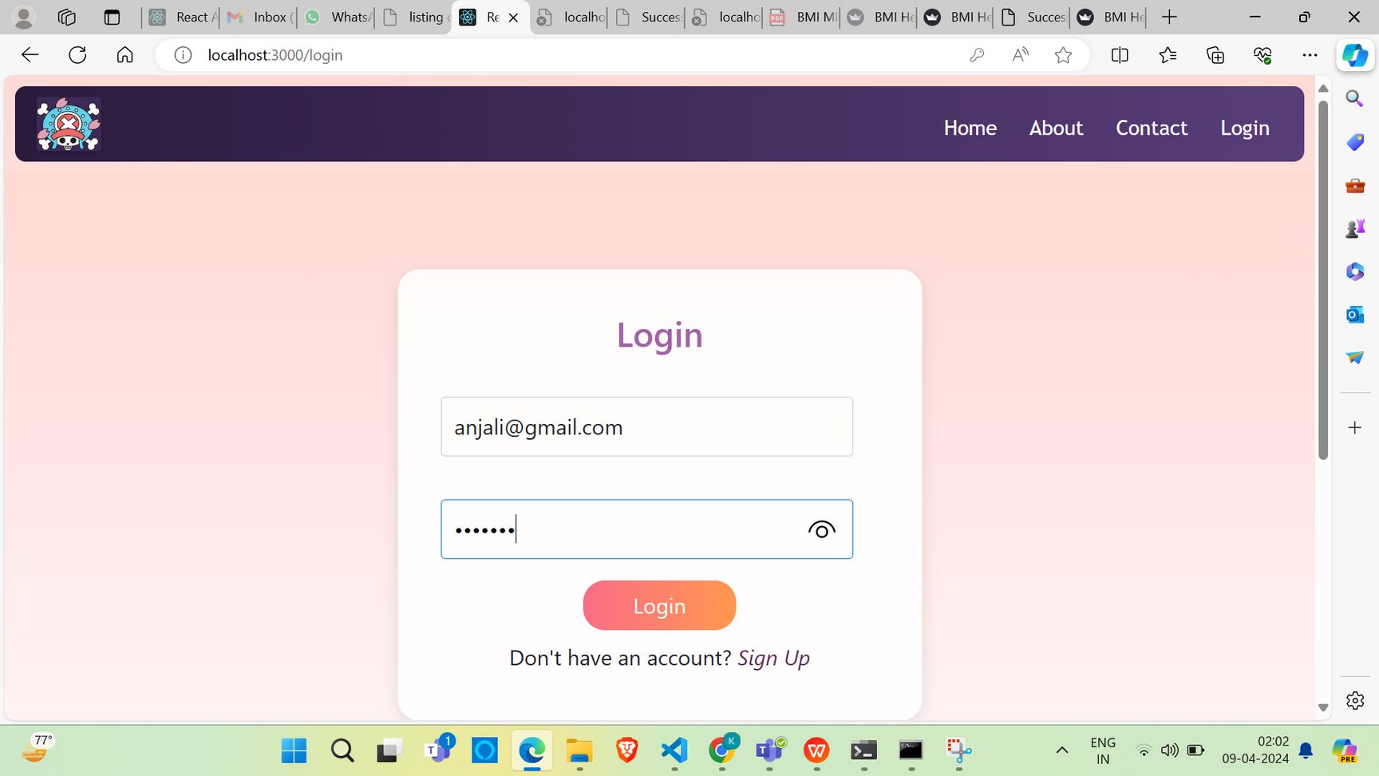
after signin going to login

Slide 21

after successful login redirected to main page

Slide 22
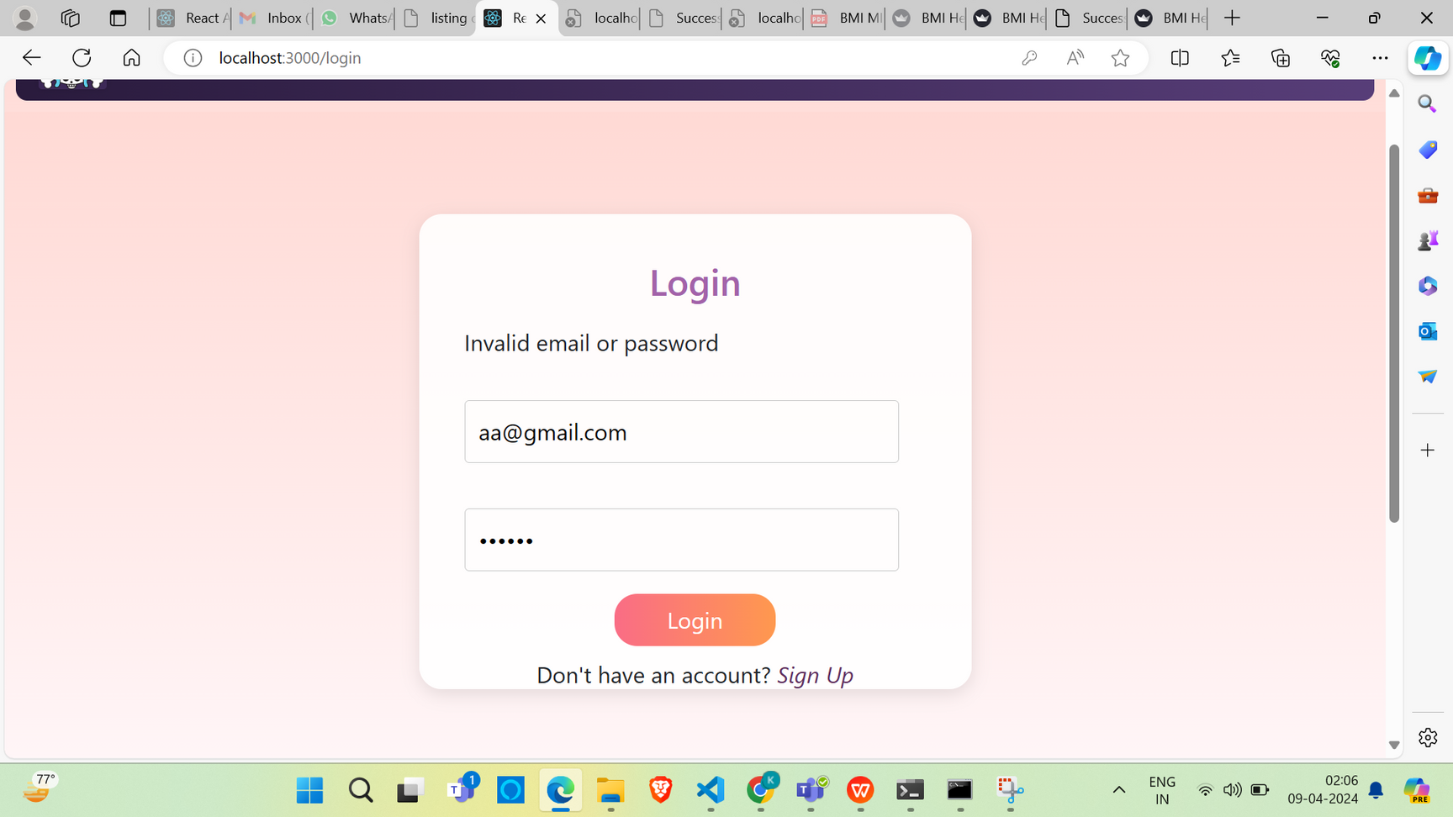
invalid login

Slide 23
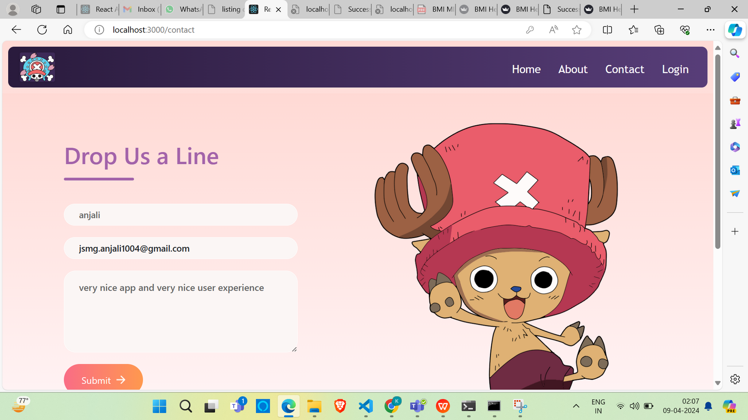
contact page

Slide 24
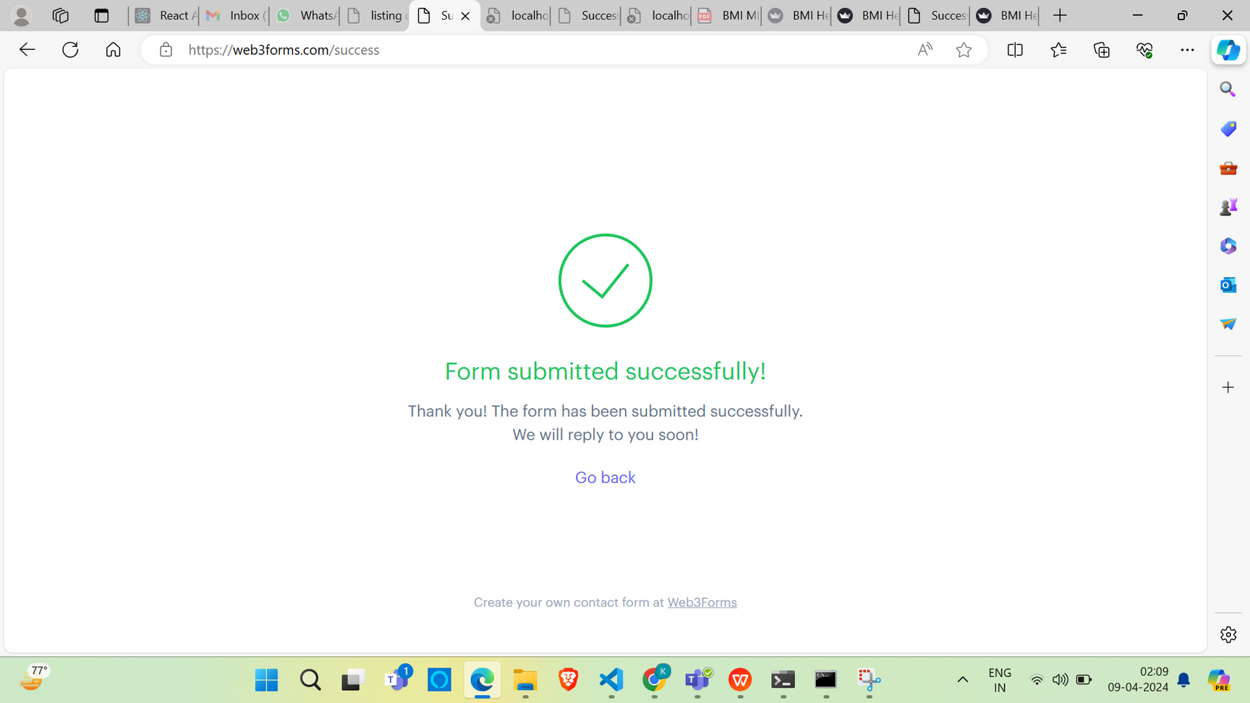
submitted successfully

Slide 25
Use of Web3Forms
for getting responses on my email, I registered my email on web3forms and I got an access key which I added in my contact.js file of the components folder of BMI-Health-Recommendation-System-main.So that I can get the reaction on my email.The screenshots are attatched here.

Slide 26
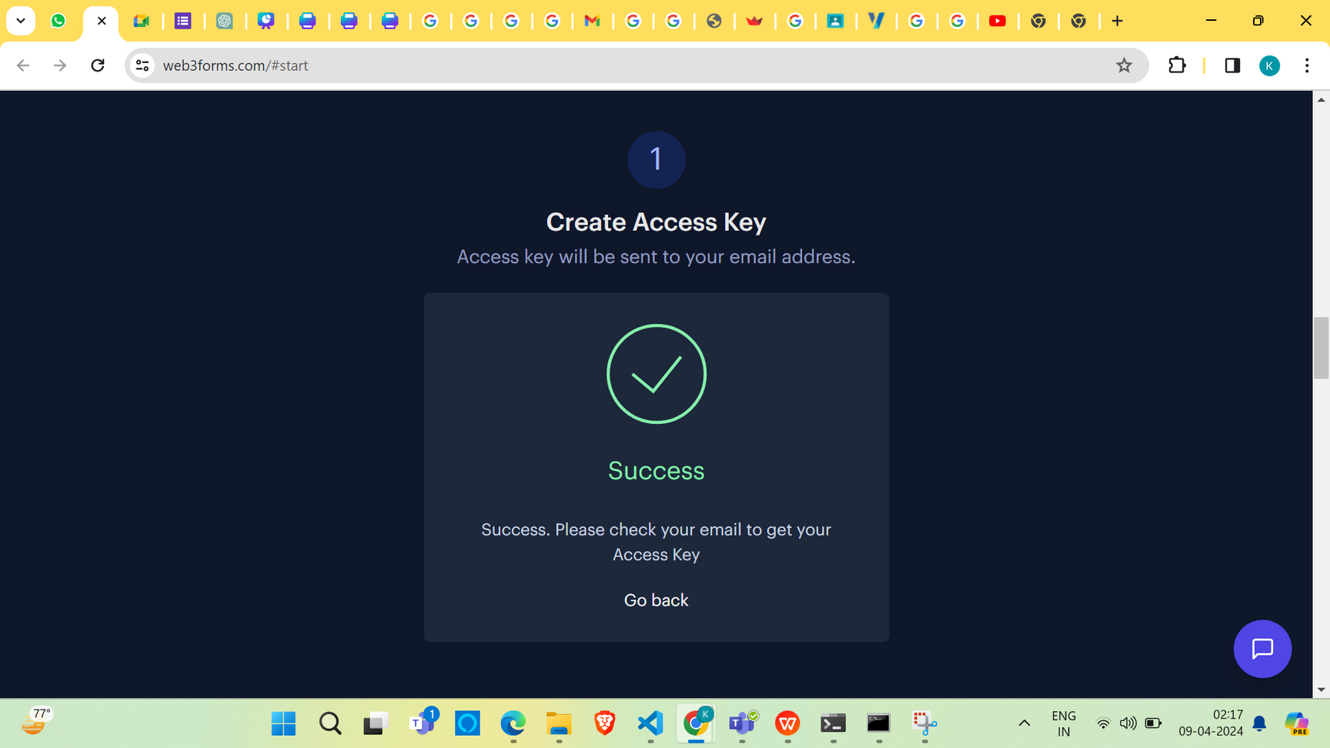
web3forms

Slide 27
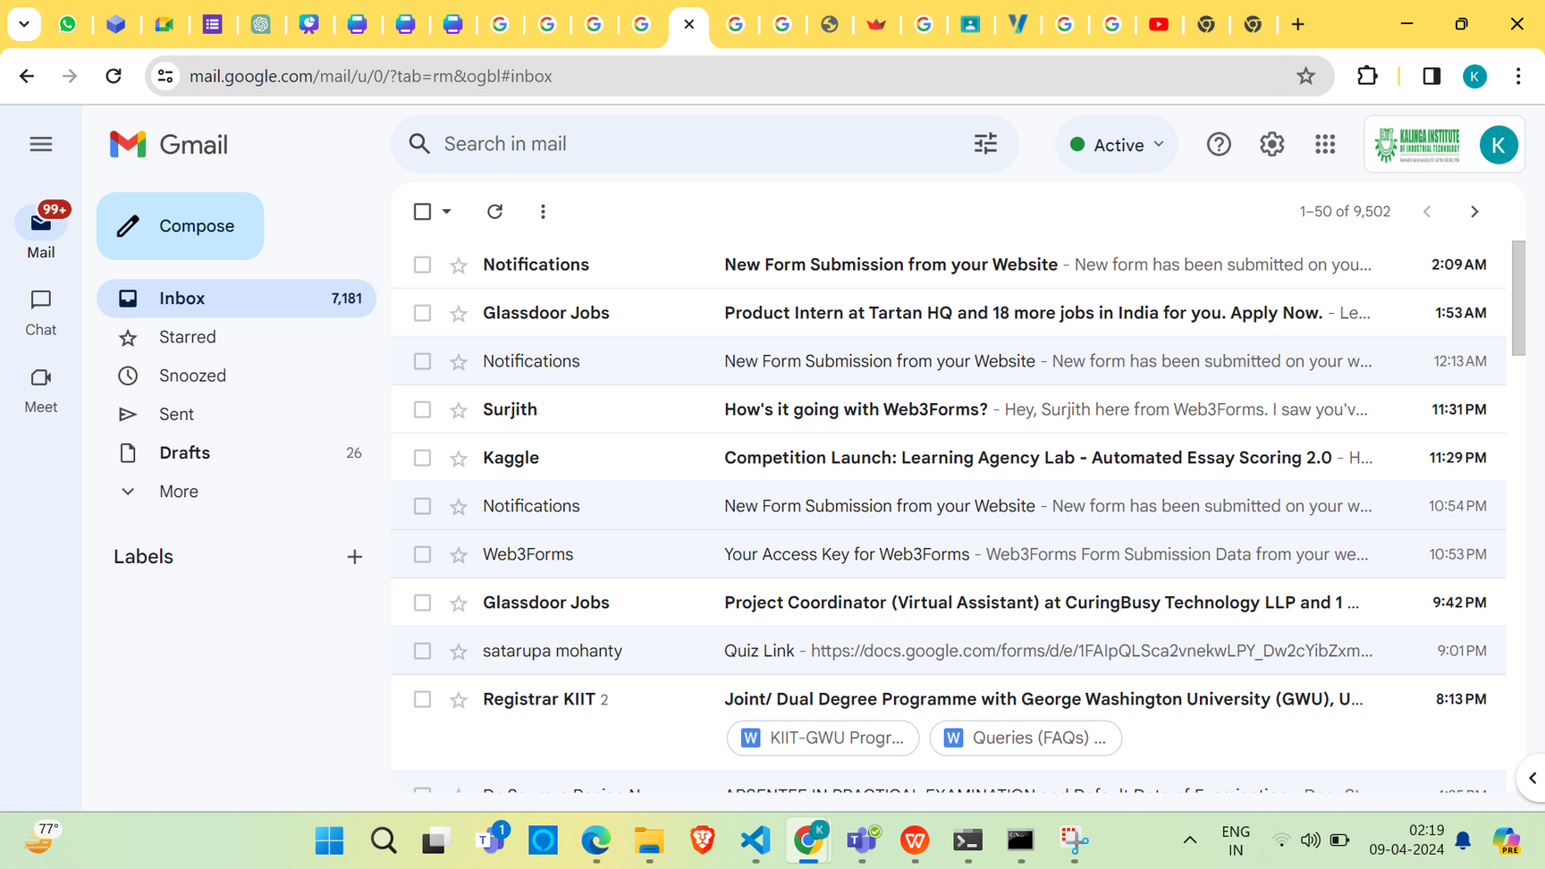
getting a notification on my email

Slide 28
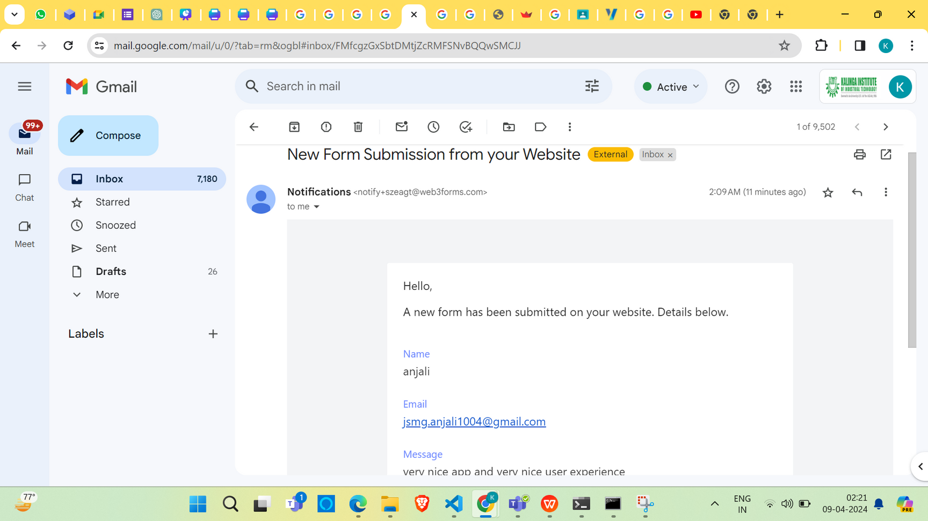
opening the email

Slide 29
The database part
BmiModel.py in the BMI Model folder is responsible for all database management.It has the use of SQLite.The database is essential for persisting user information across sessions and ensuring that user credentials are securely managed. It allows the application to maintain a consistent state, even if the server is restarted or the application is closed. The use of SQLite makes it a lightweight solution that doesn’t require a separate database server, which is suitable for small-scale applications like this one.

Slide 30
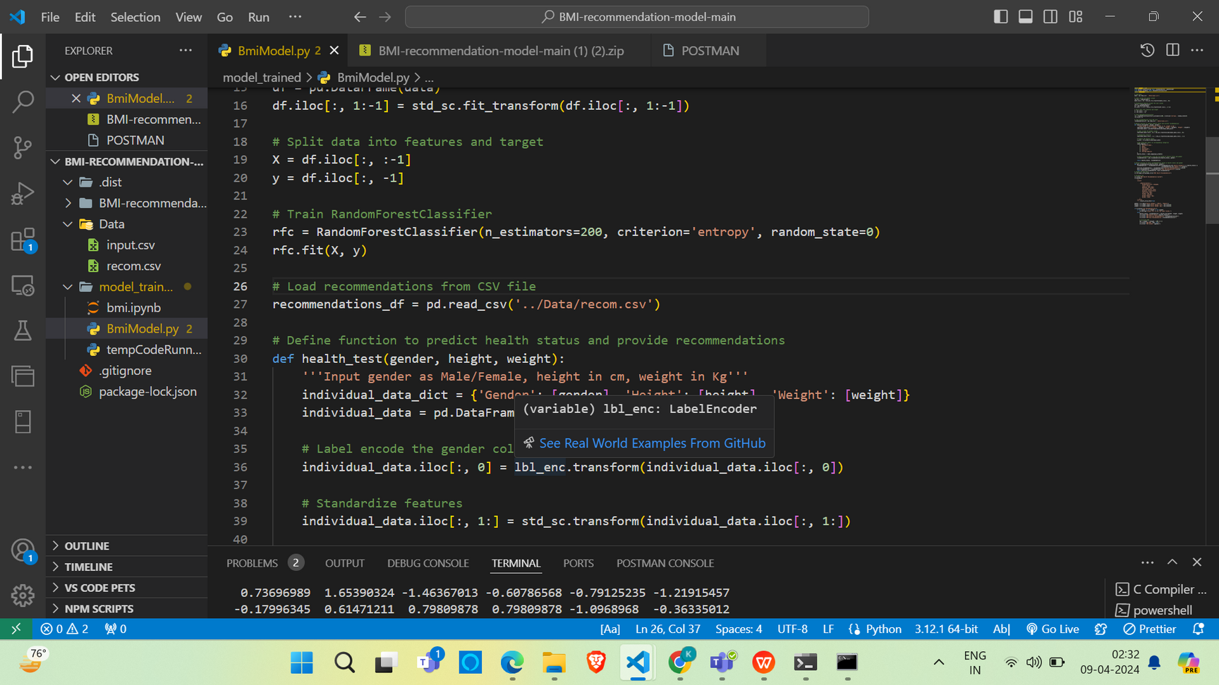
screenshot

Slide 31
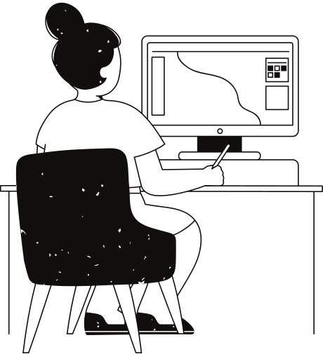
Use of ML Model
Random Forest Regression is an ensemble learning method used for regression tasks, which involves predicting a continuous value or variable (such as prices, temperatures, etc.) based on given input features. It builds on the concept of decision trees and is part of the broader family of Random Forest algorithms, which can be used for both classification and regression tasks.Here the random forest regression model is used to find BMIand return it to the server of website.

Slide 32
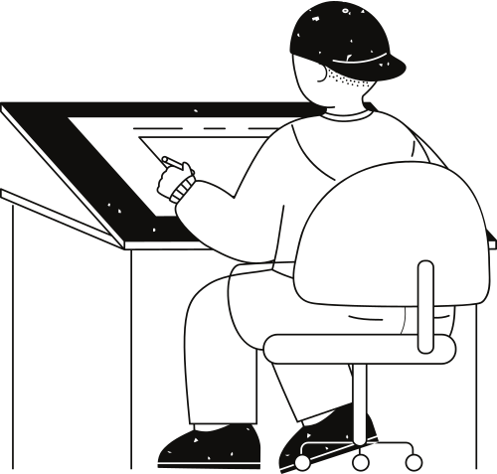

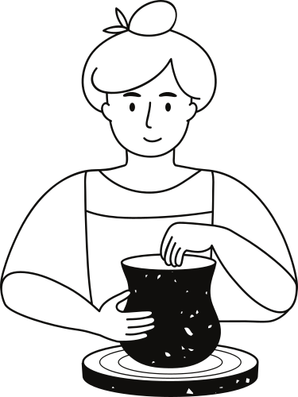

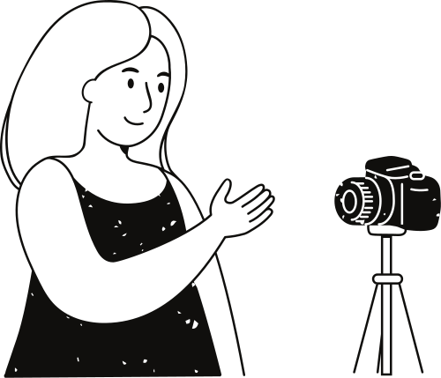
FRONTEND:React
MACHINE LEARNING ALGORITHM USED:Random Forest Classifier
Basic Concepts Used
BACKEND:Flask
DATABASE:SQLite
FOR INTERACTIVE WEB APPLICATIONS:Streamlit

Slide 33
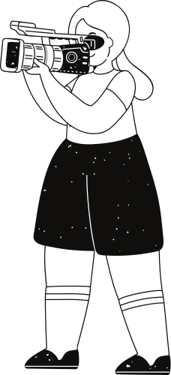
FUNCTIONAL REQUIREMENTS
NON-FUNCTIONAL REQUIREMENTS
Functional Requirements tell what a system should do
Non-functional requirements (NFRs) specify criteria that can be used to judge the operation of a system, rather than specific behaviors
User Authentication, User Registration, : Health Data Input, BMI Calculation, Personalized Healthcare Recommendation
Response Time, Data Privacy, :Authentication and Authorization, scalability
EXAMPLES
EXAMPLES

Slide 34
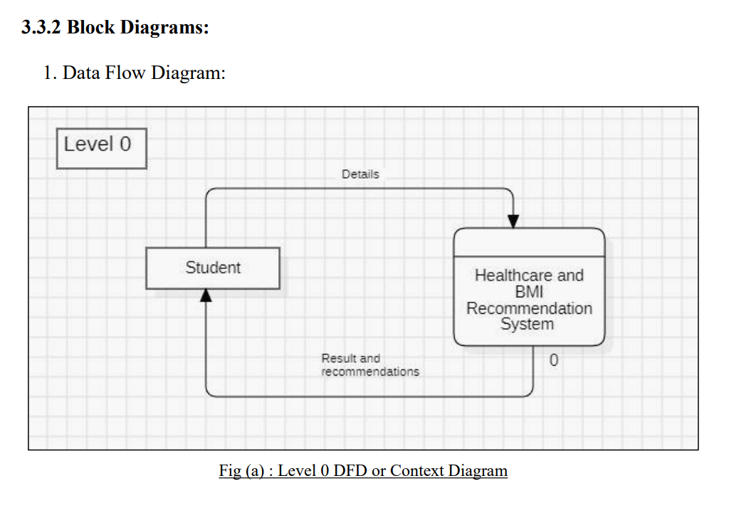
BLOCK DIAGRAM
DFD
DFD level 0
During the structured analysis , the SRS document is transferred into data flow model or DFD in DFD 0 one system/process is there depending on which external entities are maintained.Here online BMI system is the system/process and student is the external entity

Slide 35
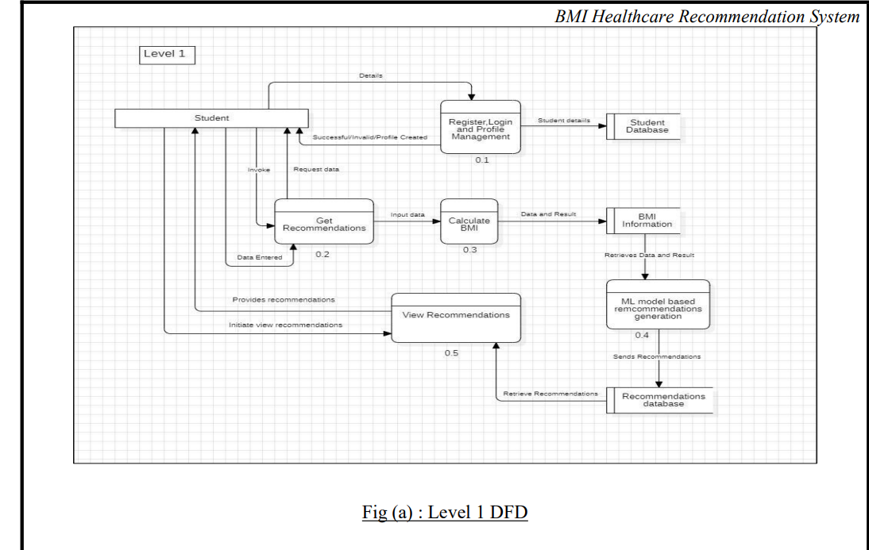
DFD level 1
inDFD level 1 the process will be classified further .Here the process is BMI
Healthcare , which is further classified into regiter,login,calculate BMI,view Recommendations,all of which are further connected to databases for the referral and data

Slide 36
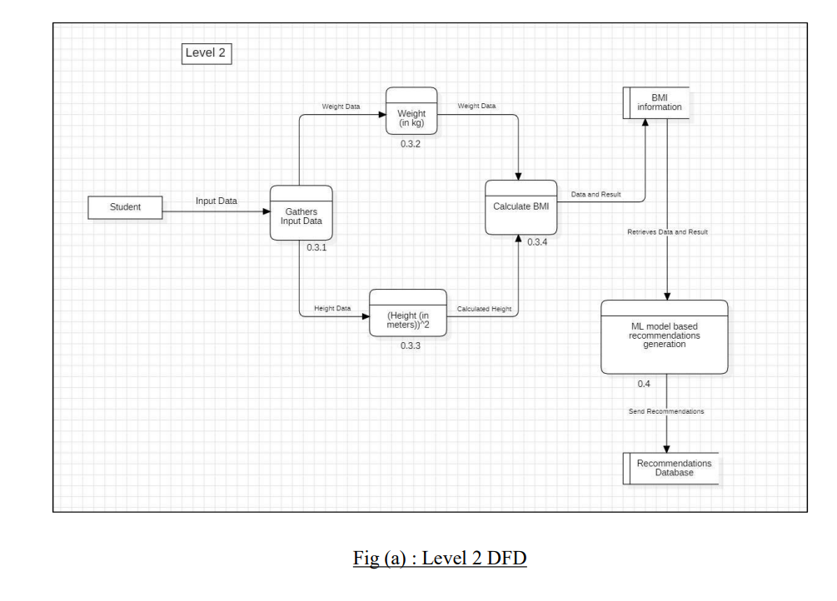
DFD level 2
In DFD level 2 the processes are explained into more details .Say for example one of the processes in our BMI app are calculation of BMI .So in level 2 DFD we will have it in more detail like enter the weight in kg,the height in cm and the gender and then calculation of BMI will be done.

Slide 37
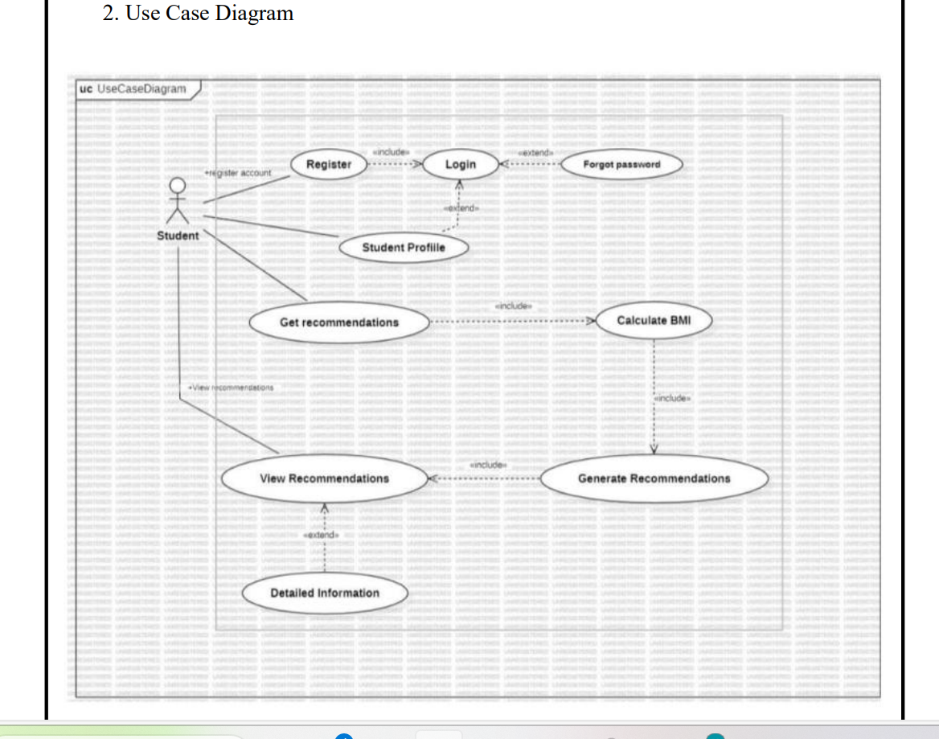
use case Diagram
Deals with whatever function was performed by the system here student is the actor.Actor is basically the thing which interacts with the system.Over here BMI Healthcare Recommendatiuon System is the System/software
Here we have the concept of include and extend relationship.The factors which are joined with include generalization are necessary for continuation with the software and the factors which are joined with extend are not mandatory.They are optional

Slide 38
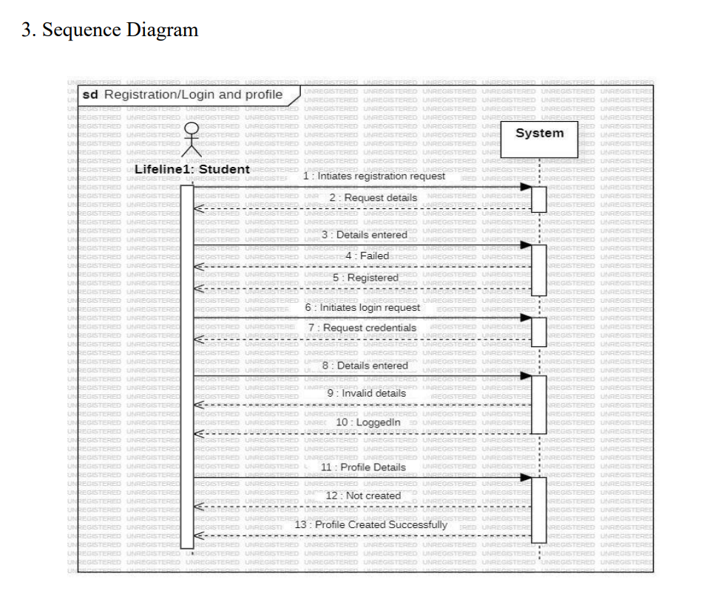
SEQUENCE DIAGRAM
It is an interaction diagram that emphasizes the time ordering the message.The hollow rectangle is the activation time and solid arrow is the message request and the dotted arrow is the responnse message.Say example student registration .Here student enters the details,everytime student enters or requests something during the registration example, it comes under message request and everytime the app responds is response message

Slide 39
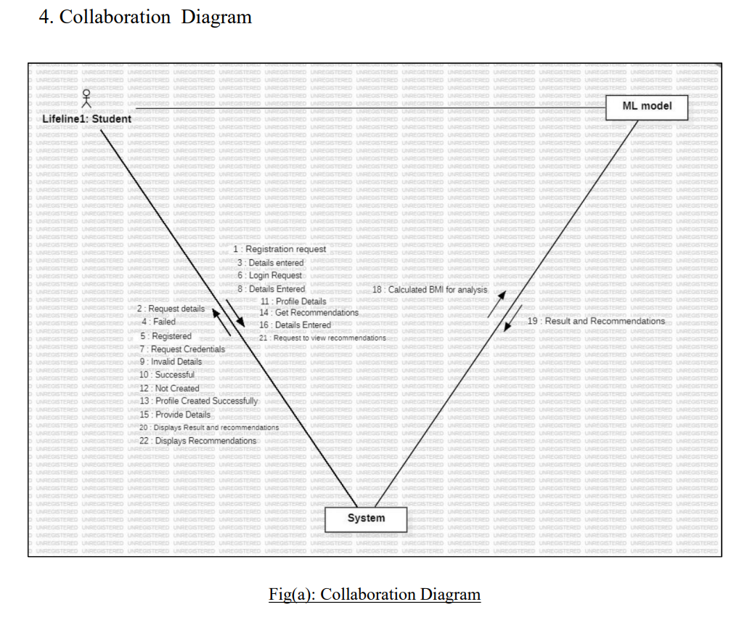
COLLABORATION DIAGRAM
It is an interaction diagram that emphasizes the structural organization of the object send and recieve message say for example the student will enter the details:-registration calculate BMI and recommendation to the . system and the system eill send the calculated BMI to the
ML model for analysis. which in turn will give result with recommendation

Slide 40
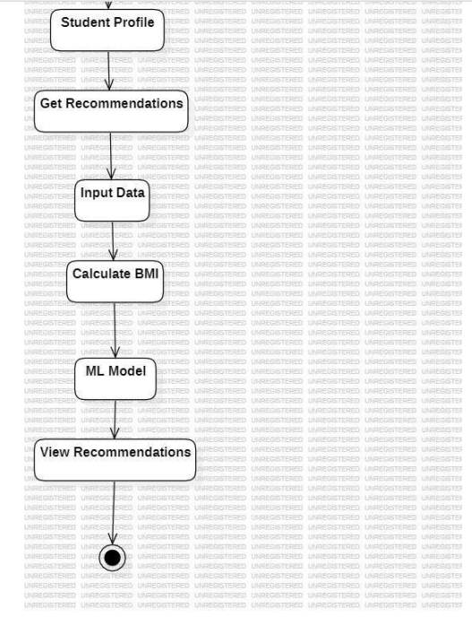
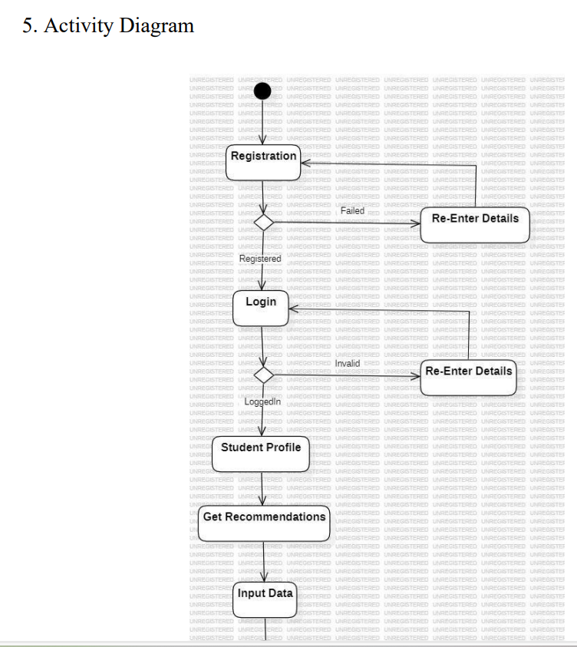
ACTIVITY DIAGRAM

Slide 41
POINTS
In activity diagram we have a list of activities which are performed during the system operationthe dark sircle in the beginning remarks beginning of process and the hollow circle marks the end.The arrows are the relationship between the object and the rectangles are the object like login , BMI Recommendations and so on.The diamond is the selection whether you want to login or not.We also have fork join for parallel activities .

Slide 42
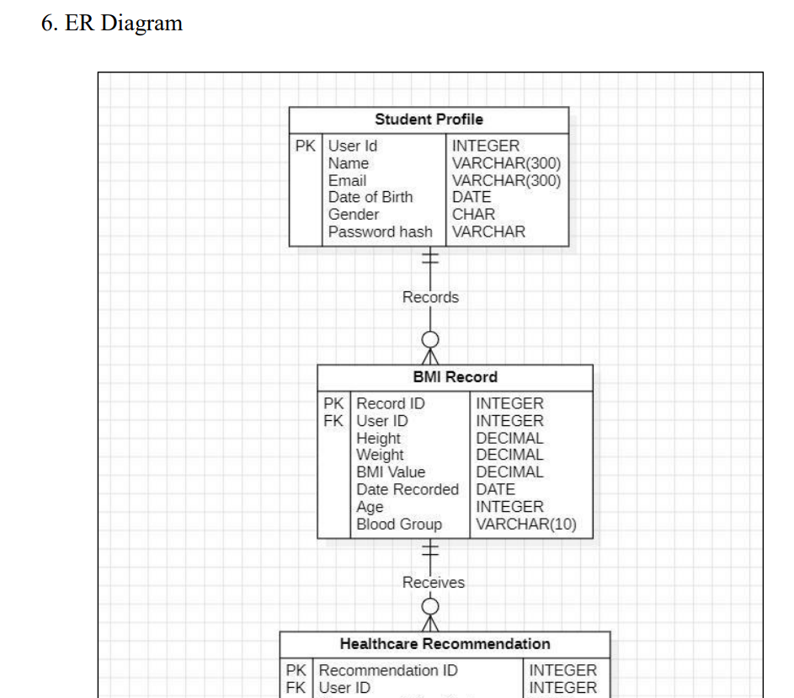
ER Diagram
The work of an ER Diagram is to explain the relationship among entities present in the database.A part of the ER diagram is displayed

Slide 43
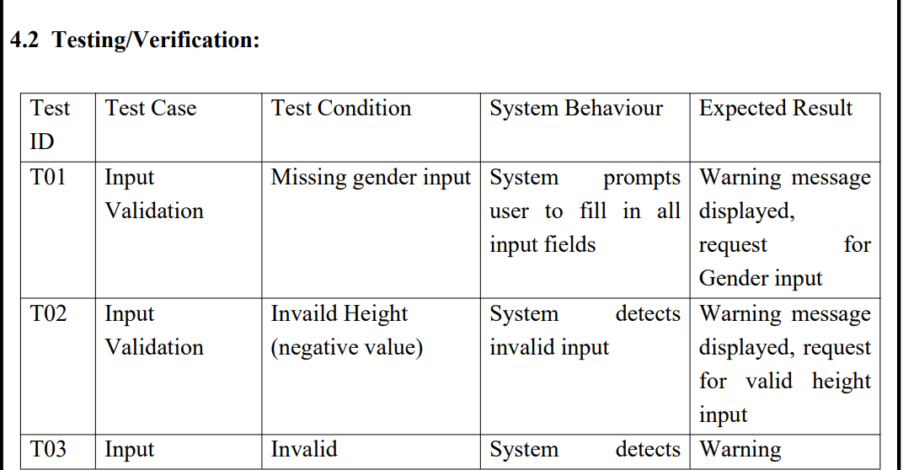
TESTING AND VALIDATION
In testing/validation, all possible expected valid and invalid inputs are taken and checked what is the response of the software, it is giving the output or not.

Slide 44
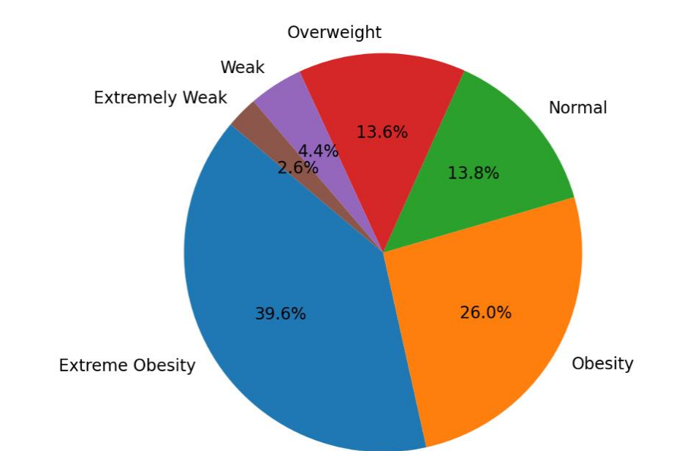
RESULT ANALYSIS
out of the total number of people who had entered their details, analysis of result is done that who are overweight,normal malnutritioned and so on.

Slide 45
DESIGN STANDARD:Unified Modeling Language (UML) standards for creating diagrams to visualize the system architecture, such as use case diagrams, class diagrams, and sequence
01.
STANDARDS ADOPTED
CODING STANDARDS: We followed the 'Write as few lines as possible' principle to keep our code concise and readable. Additionally, we used appropriate naming conventions to improve code clarity and adopted the practice of segmenting blocks of code into paragraphs to enhance code organizat
02.
TESTINGS STANDARDS: During the testing phase, we followed the IEEE 829 standard for test documentation, which outlines the format and content of various testing documents such as test plans, test cases, and test reports.By following this standard, we ensured thorough testing and verification of our project w
03.

Slide 46
Conclusion
our web-based BMI Health Recommendation System, powered by the Random Forest Classifier, stands as a significant advancement in personalized health management. By utilizing data-driven insights, our platform offers tailored exercise and diet recommendations, providing users with practical tools to enhance their well-being. Our commitment to user privacy and data security ensures that individuals can trust our system to safeguard their information. Looking ahead, we aim to further refine our platform through ongoing research and collaboration with healthcare professionals, with the ultimate goal of promoting healthier lifestyles and empowering individuals to take control of their health journey.

Slide 47
the
end

